Slide 1
Sequencing Technology
From Sanger to single molecules — updated for 2026
Notes:
Deck restyled and updated September 2026. Content from the original lecture is preserved; slides marked "2026 update" add platforms and figures current as of 2026.

Slide 2
Three generations of sequencing technology
1
2
3
FIRST GENERATION
SECOND GENERATION
THIRD GENERATION
Sanger
Short-read
Single molecule
1977 →
2005 →
2011 →
Chain termination, gel then capillary electrophoresis. One read per reaction, ~1 kb, very accurate.
454 (2005–2016) and Illumina (2006 →), now joined by Element, Ultima, MGI and Roche SBX. Billions of reads in parallel.
PacBio SMRT (HiFi) and Oxford Nanopore. Reads of 10 kb to >1 Mb from native DNA, no amplification.

Slide 3
Terminology
History of Sequencing
PART 1 OF 6
Terminology
Current Sequencing Technologies
Prepping DNA for Sequencing
General Study Design Considerations
Considerations for Specific Sequencing Assays

Slide 4
What is a sequencing read? What is a sequencing library?
Read
Paired reads
A single sequence from one fragment in the sequencing library (one cluster, bead, well, or molecule).
Two reads derived from one fragment in the library — one read from each end.
Library
Coverage
A pool of DNA fragments that have been prepared to be sequenced.
The number of reads spanning a particular base in the genome (e.g., “30×”).

Slide 5
Types of reads: fragment and paired-end
Fragment (single-end) reads
Paired-end reads
Come from fragment libraries. A single read in one direction from each fragment.
Also from fragment libraries. Two reads from opposite ends of the same fragment — the reads point towards each other.
Read 1
Read 1
Read 2
library fragment
library fragment

Slide 6
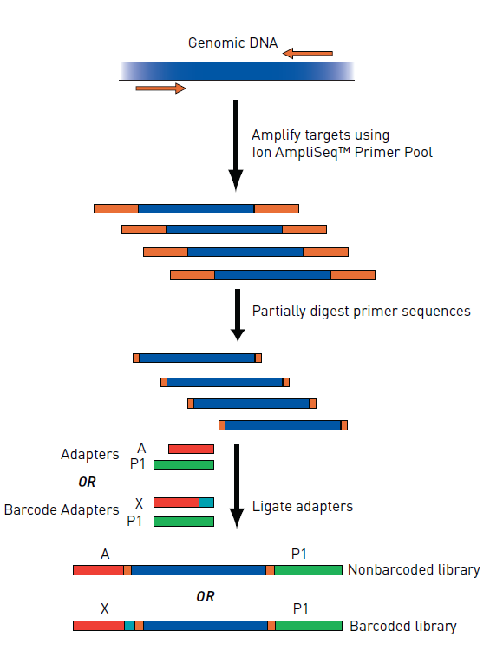
Sequencing Library
DNA that has been prepared for sequencing
Difference preparations for difference sequencing tech
  Sanger
    PCR
  2nd and 3rd Generation
    Need to ligate adapters/barcodes

Slide 7
Terminology
History of Sequencing
PART 2 OF 6
History of Sequencing
Current Sequencing Technologies
Prepping DNA for Sequencing
General Study Design Considerations
Considerations for Specific Sequencing Assays

Slide 8
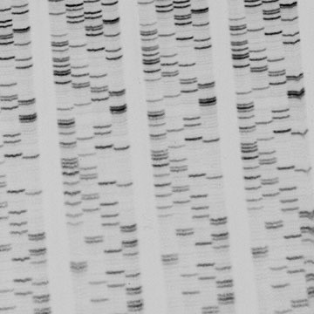
Sanger sequencing (1977)
1977
Sanger, Nicklen & Coulson, PNAS: “DNA sequencing with chain-terminating inhibitors”
5,386 nt
φX174 — the first DNA genome sequenced
1980
Nobel Prize in Chemistry to Sanger and Gilbert (with Berg)
Image credit: unlockinglifescode.org/timeline/11

Slide 9
How Sanger sequencing originally worked
1
Split into four separate PCR reactions
Single-stranded template DNA is divided four ways.
TERMINATED PRODUCTS, SORTED BY LENGTH
primer–A*
2
Add labeled primer and nucleotides
primer–AT*
Each reaction gets all four dNTPs plus a little of one chain-terminating ddNTP (no 3′-OH).
primer–ATG*
primer–ATGC*
3
Allow the strands to extend
primer–ATGCC*
Extension sometimes stops at a ddNTP, giving a nested set of fragments.
primer–ATGCCT*
4
Separate by size on Gel
* = ddNTP, the labeled terminating base
Shortest to longest fragment spells the sequence 5′ → 3′.
Read: 5′-ATGCCT-3′
Notes:
Diagram redrawn in 2026 update; content follows the original four-step slide.

Slide 10
Automation of Sanger sequencing (1986)
Radioactive labels replaced with laser-excitable fluorescent dyes
All four nucleotides could be run in a single lane of a gel
Bases read off with a camera as fluorescing strands passed a fixed point near the end of the gel
Each lane’s signal converted to sequence computationally — “base calling”
ONE DYE PER BASE, ONE LANE
A
ddATP dye
C
ddCTP dye
G
ddGTP dye
T
ddTTP dye
ABI 370A, 1987 — the first commercial automated sequencer

Slide 11
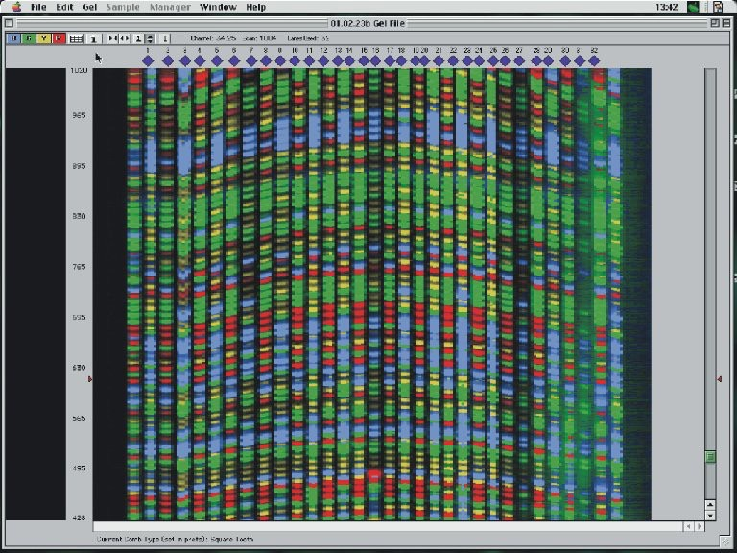
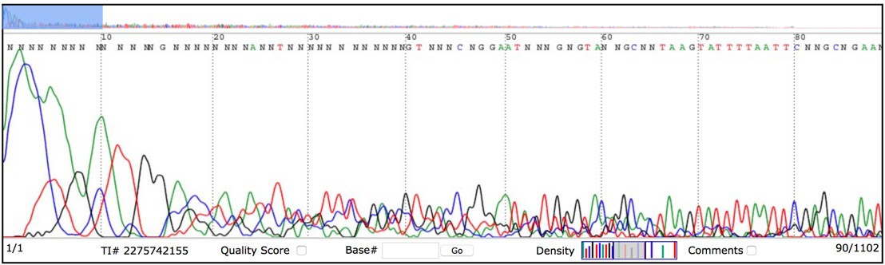
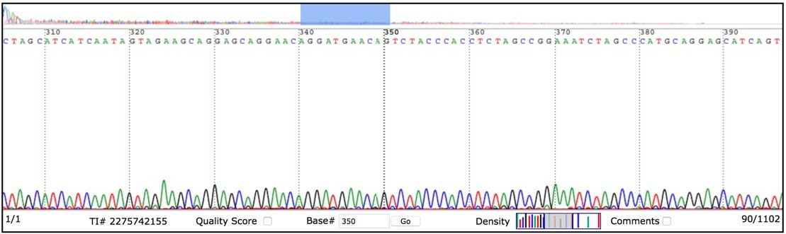
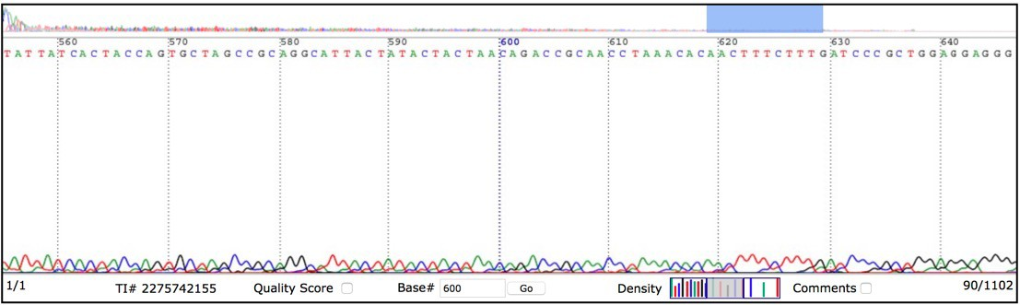
Fluorescent slab gel image
Image credits: mun.ca/biology/scarr/How_it_works.htm (gel); NCBI Trace Archive (traces)

Slide 12
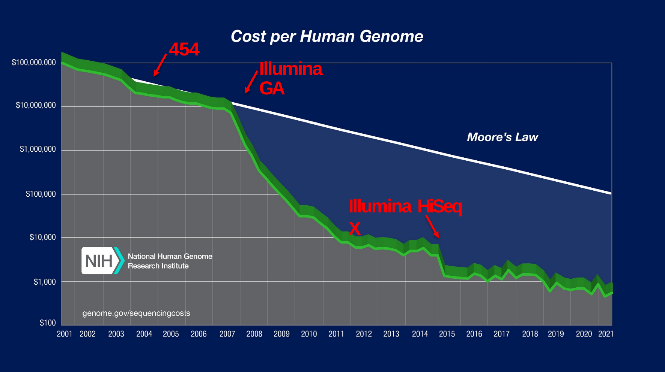
Cost curve: the Sanger era
Roughly steady decline
Through the capillary era, costs fell at about the pace of Moore’s law.
The first human genome cost ~$100 million per genome in 2001 (NHGRI estimate).
Source: NHGRI, genome.gov/sequencingcosts

Slide 13
Limits on Sanger gel performance
Trade-off between loss of signal from diffusion and loss of resolution at high voltage or short gel length
Longer gels/capillaries or lower voltages separate short-to-medium fragments better
But longer run times mean more diffusion, which blurs adjacent signals and spreads peaks
MAXIMUM HIGH-QUALITY READ
~1,000 bp
A physical limit of electrophoresis — not of the chemistry.

Slide 14
454 sequencing
The first “next-generation,” massively parallel technique (2005)
Based on pyrosequencing
Emulsion PCR prepares DNA on beads
Beads are loaded into a picotiter plate for sequencing
2005
GS 20 launched; Margulies et al., Nature
2016
Roche discontinued 454 sequencers

Slide 15

Rover

Slide 16
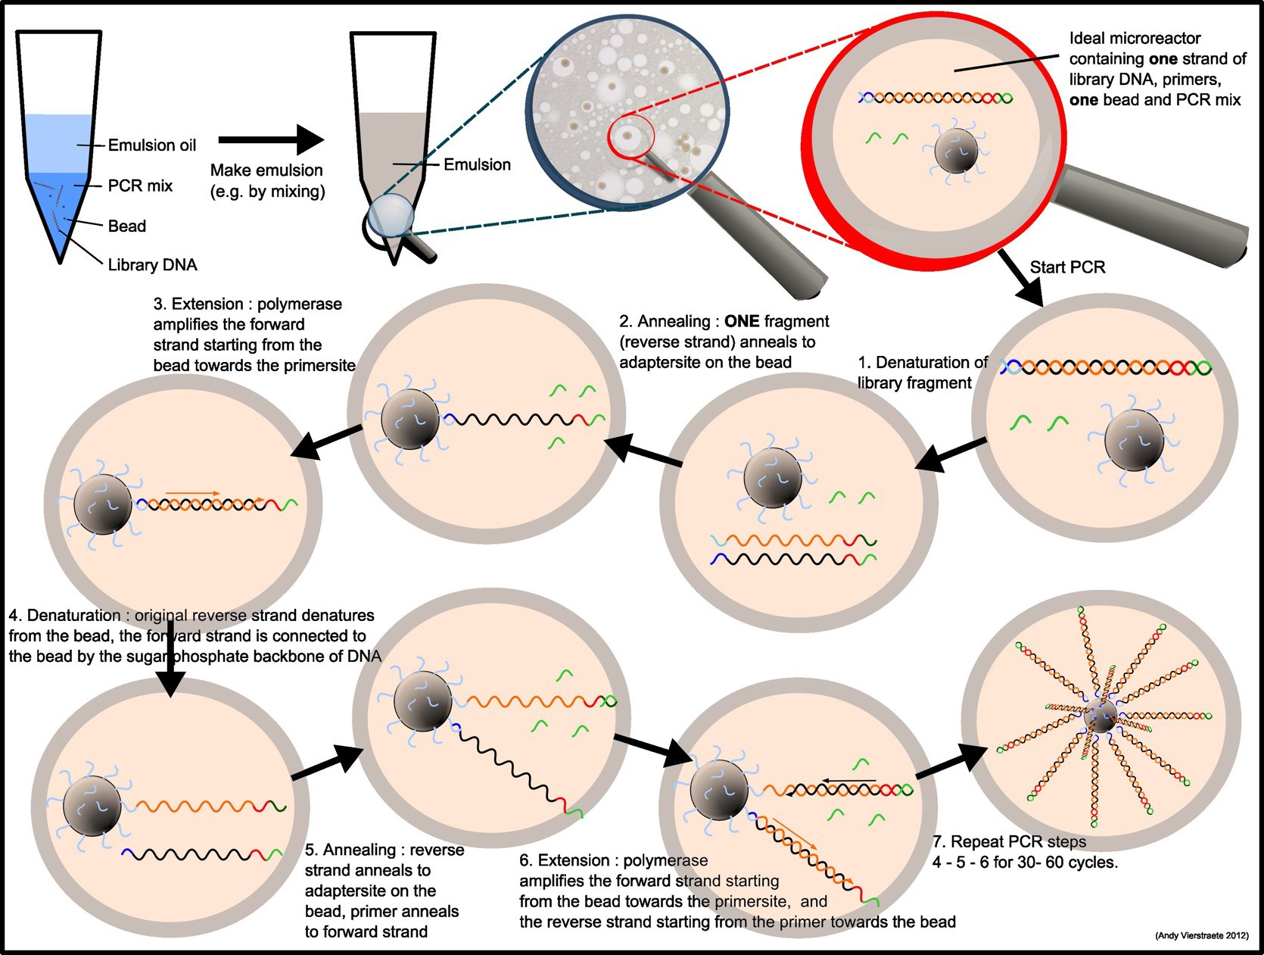
Emulsion PCR
One molecule, one bead
Oil–water emulsion makes millions of micro-reactors
Ideally one template and one bead per droplet
PCR coats each bead with clonal copies
Break the emulsion; enrich template-carrying beads
Image credit: users.ugent.be/~avierstr/nextgen/nextgen.html

Slide 17
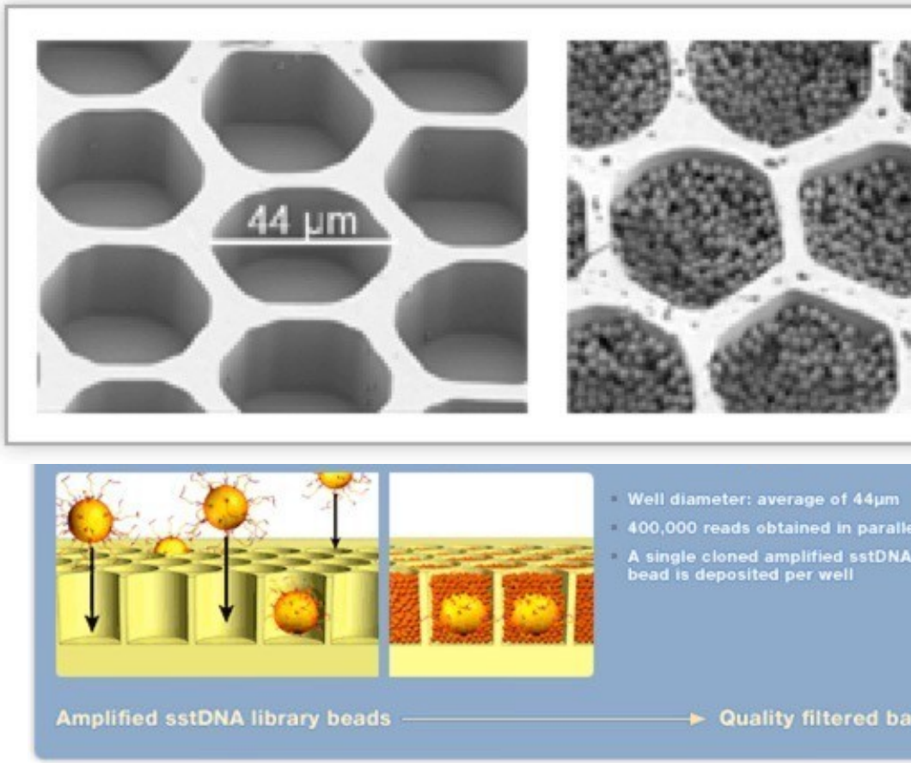
454 picotiter plate
44 µm
average well diameter
1 bead
per well, each carrying one clonal template
~400,000
reads in parallel (early plates)
Image credit: mbio.ncsu.edu/MB451/lectureModules/molecularEcology/molecularSurveys/454/454.html

Slide 18
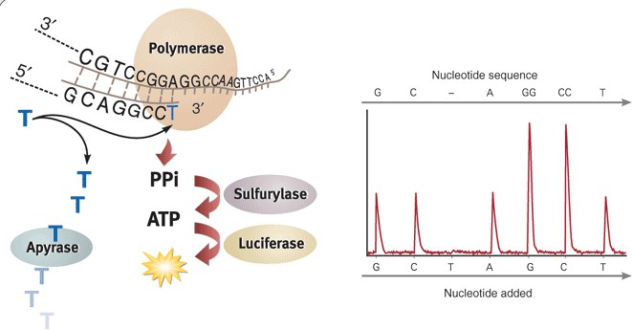
Pyrosequencing
Light from each incorporation
Flow one nucleotide at a time
Incorporation releases pyrophosphate (PPi)
Sulfurylase: PPi → ATP; luciferase: ATP → light
Apyrase clears leftovers before the next flow
Light is proportional to the number of bases added

Slide 19
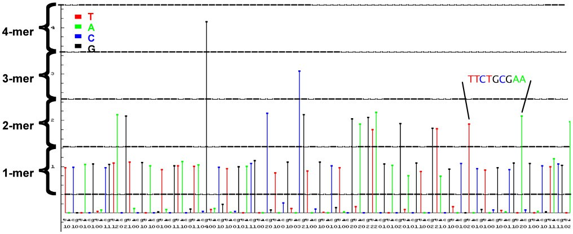
454 output: the flowgram
Signal height counts homopolymer length (1-mer, 2-mer, 3-mer…). Distinguishing 5 from 6 identical bases is where 454 errors come from.
Image credit: contig.wordpress.com/2010/10/28/newbler-input-i-the-sff-file/

Slide 20
Cost curve: the 454 era
The break from Moore’s law
Massively parallel sequencing (454 from 2005, then Illumina GA from 2006–07) pulled costs off the Moore’s law line.
Source: NHGRI, genome.gov/sequencingcosts

Slide 21
Statistics of apex 454 sequencing
~1 million
400–700
~1.5%
reads per run
bases per read
error rate — motif dependent (homopolymers)
$ thousands
~10 hours
~1 Gb
per run
per run
per machine per day

Slide 22
Limits on 454 performance
Homopolymers
Signal decay
Dephasing
Cannot accurately read homopolymers or nearby sequence; physical limit on reading the full incorporation
Loss of signal over time
Signal-to-noise degrades as extending strands fall out of sync
Fragment length
One strand only
Limited by what can be amplified on a bead in emPCR
No second-strand or non-contiguous (paired) reads

Slide 23
Terminology
History of Sequencing
PART 3 OF 6
Current Sequencing Technologies
Current Sequencing Technologies
Prepping DNA for Sequencing
General Study Design Considerations
Considerations for Specific Sequencing Assays

Slide 24
Illumina sequencing
DNA strands are amplified in situ on a glass flow cell
Reversible terminators sequence one base at a time
Solexa Genome Analyzer launched 2006; Illumina acquired Solexa in 2007
Still the dominant platform in 2026
Cluster generation
Add fluorescent reversible-terminator dNTPs
Image
Cleave dye + block
Repeat

Slide 25
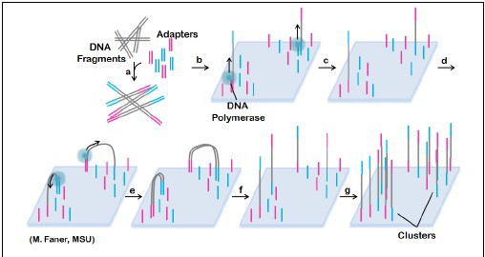
Bridge amplification

Slide 26
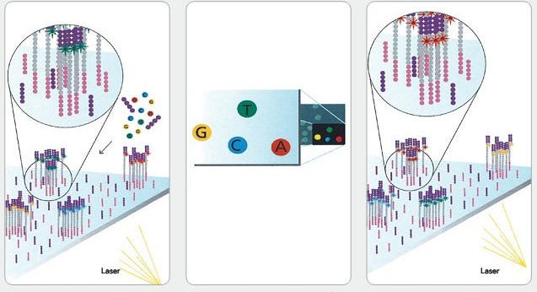
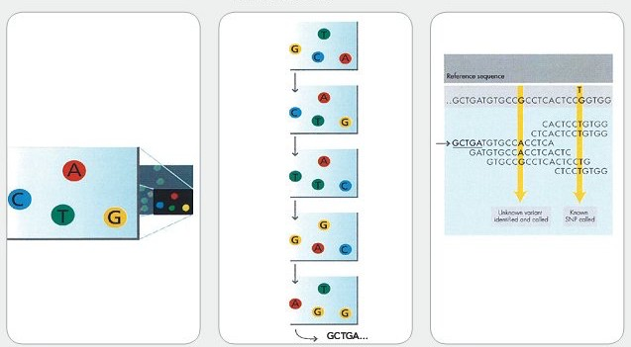
Reversible terminator sequencing

Slide 27
Statistics of Illumina sequencing (NovaSeq X 25B, 2026)
~26–35 B
2 × 150 bp
≥ Q30
read pairs per 25B flow cell; two flow cells per run
typical read length (300 bases per pair)
low error (<1%), some context dependency
~48 hours
~8–10.5 Tb
~$200
per 2 × 150 run
per flow cell; up to ~21 Tb per dual run
per 30× human genome (Illumina claim)
Notes:
Updated 2026 from Illumina NovaSeq X specifications (25B flow cell: ~52–70 billion reads PF per flow cell, i.e. ~26–35 billion pairs; ~8–10.5 Tb at 2x150; ~48 h). Original slide listed NovaSeq 6000 figures (10–25B read pairs, ~$30,000 per run, 2–3 days).

Slide 28
Limits on Illumina performance
Signal decay
Dephasing
Reagent life
Loss of signal over the course of a run
Signal-to-noise degrades as extending strands fall out of sync
Viability of sequencing reagents over a multi-day run
Fragment length
Index hopping
Limited by what can be amplified into clusters
Patterned flow cells can swap sample barcodes — use unique dual indexes

Slide 29
Cost curve: the Illumina era
2026 UPDATE
Since 2021
NovaSeq X (2022): ~$200 genome claimed
Ultima, Complete Genomics: ~$80–100 genome claims (2024–26)
PacBio SPRQ-Nx HiFi: <$300 genome (2026)
Vendor claims = reagents only; library prep, labor and compute add more
Source: NHGRI, genome.gov/sequencingcosts

Slide 30
New short-read and hybrid platforms (2022–2026)
2022
2022 / Feb 2026
Element AVITI
Ultima UG 100 → UG 200
Avidity sequencing: multivalent fluorescent “avidites” bind, then unlabeled nucleotides incorporate. Benchtop, very high base accuracy.
Open silicon wafer spun under reagents; mostly natural nucleotides. UG 200 Ultra: >60,000 30× genomes per year.
2015 →
June 2026
MGI / Complete Genomics DNBSEQ
Roche AXELIOS 1 (SBX)
DNA nanoballs from rolling-circle amplification on patterned arrays; low-cost, high-throughput short reads.
Sequencing by expansion: DNA is copied into a ~50× longer “Xpandomer” and read through a nanopore array. Reads up to ~1.5 kb; same-day genomes.
Notes:
New slide (2026). Sources: Ultima UG 200 launch, 23 Feb 2026 (GEN); Roche AXELIOS 1 launch press release, 29 June 2026 (research use only); Element AVITI (Arslan et al., Nat Biotechnol 2024); Complete Genomics / MGI DNBSEQ.

Slide 31
CURRENT TECHNOLOGIES
Single-molecule (third-generation) sequencing

Slide 32
Single-molecule methods
OPTICAL
ELECTRICAL
Pacific Biosciences SMRT
Oxford Nanopore Technologies
Single Molecule, Real-Time sequencing
Polymerase anchored in a zero-mode waveguide (ZMW)
All wells imaged at once, in real time
Bases called from the light flash at incorporation
Instruments: Revio (high-throughput) and Vega (benchtop)
Protein nanopores in a synthetic membrane thread DNA through
Current sensors read the change in ionic current as groups of bases occupy the pore
From USB-sized MinION to 48-flow-cell PromethION

Slide 33
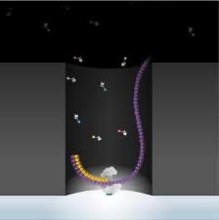
PacBio SMRT
Watching one polymerase
A ZMW is a nanoscale well so small only its floor is illuminated
Each labeled nucleotide flashes as it is held by the polymerase
Kinetics also reveal base modifications such as 5mC
Video: youtube.com/watch?v=WMZmG00uhwU

Slide 34
PacBio HiFi reads
Size-selected libraries, ~15–20 kb
Circular template: the polymerase reads around it many times
Circular consensus (CCS) of the passes gives very accurate long reads (>99.9%, Q30+)
Assembles easily and can even distinguish highly similar repeats
2019
HiFi reads introduced (Wenger et al.)
2023–24
Revio (25 M ZMWs) and benchtop Vega
<$300
per HiFi human genome with SPRQ-Nx (2026)

Slide 35
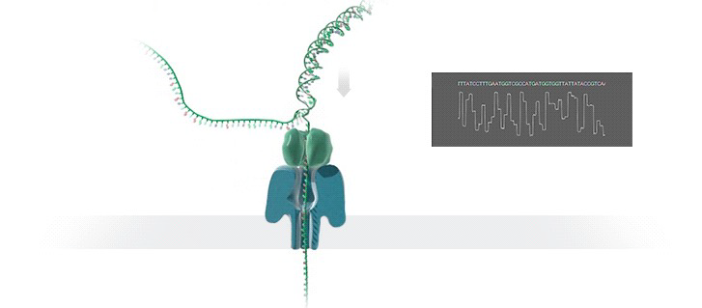
Oxford Nanopore

Slide 36
Current state of Oxford Nanopore — then vs. 2026
 | Original slide (~2019) | 2026
Read length | Very long (100 kb+, >1 Mb) | Unchanged: read length = fragment length; >1 Mb possible
Accuracy | High error (10%+), non-random | ~99.75% simplex (Q26, R10.4.1 + Dorado v5); duplex >Q30
Throughput | Low | PromethION runs up to 48 flow cells; high-output flow cells (2026)
Run time | Few hours to 3+ days | Still flexible; real-time analysis; stops when pores wear out
Extras | — | Direct 5mC/6mA and RNA modification calls; direct RNA; peptide-sequencing demo (2026)
Notes:
Updated 2026. Accuracy from nanoporetech.com/platform/accuracy (Q26, Dorado v5 SUP); London Calling 2026 technology update (PromethION Plus flow cell, peptide sequencing demonstration).

Slide 37
Limitations of single-molecule techniques — revisited
Limitation (original) | Where things stand in 2026
No redundancy, so high error unless the molecule is read more than once | Largely solved: HiFi circular consensus; better pores and AI basecallers
Detection is hard to massively parallelize | 25 M ZMWs per Revio cell; 48 flow cells per PromethION
Requires large amounts of DNA | Lower-input protocols exist, but more DNA than short reads still helps
Very long reads need very high-quality input DNA | Still true — HMW extraction is often the bottleneck
Data processing and base calling are expensive | Still compute-heavy (GPUs), but routine and increasingly on-instrument

